Slide 1

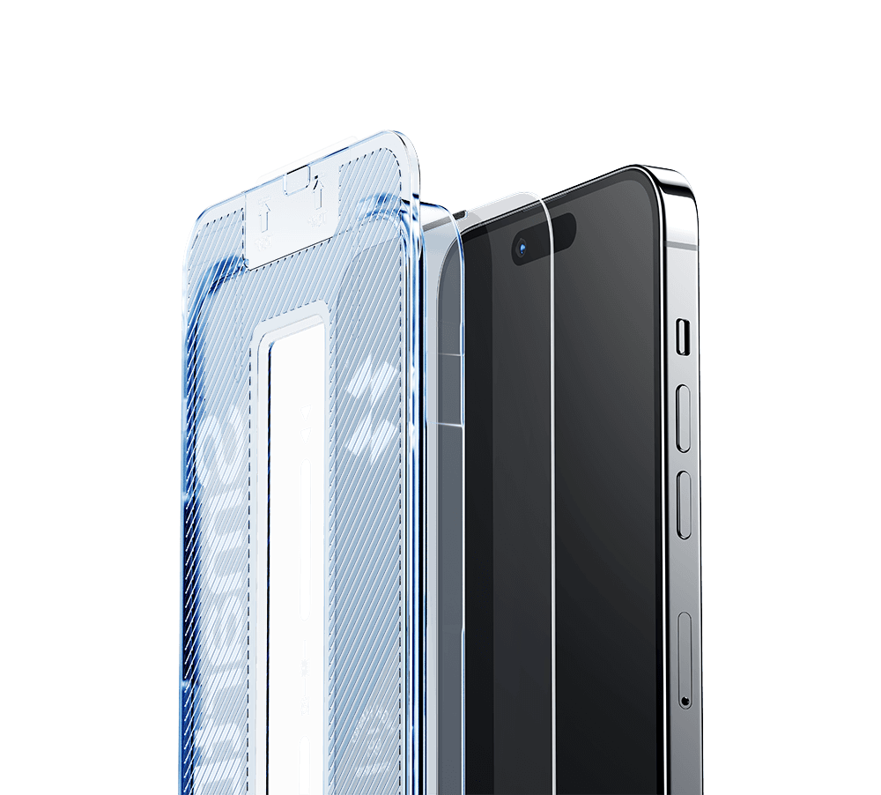


The 16th National University Business Elite Challenge
SHANMO
Screen Protector with Dust-Free Installation
Malaysia Market Product Launch event

Slide 2




A REAL LIFE STORY
Real User Insight
+ 61%
The reason for this behavior
A NEW BUSINESS OPPORTUNITY！

Slide 3
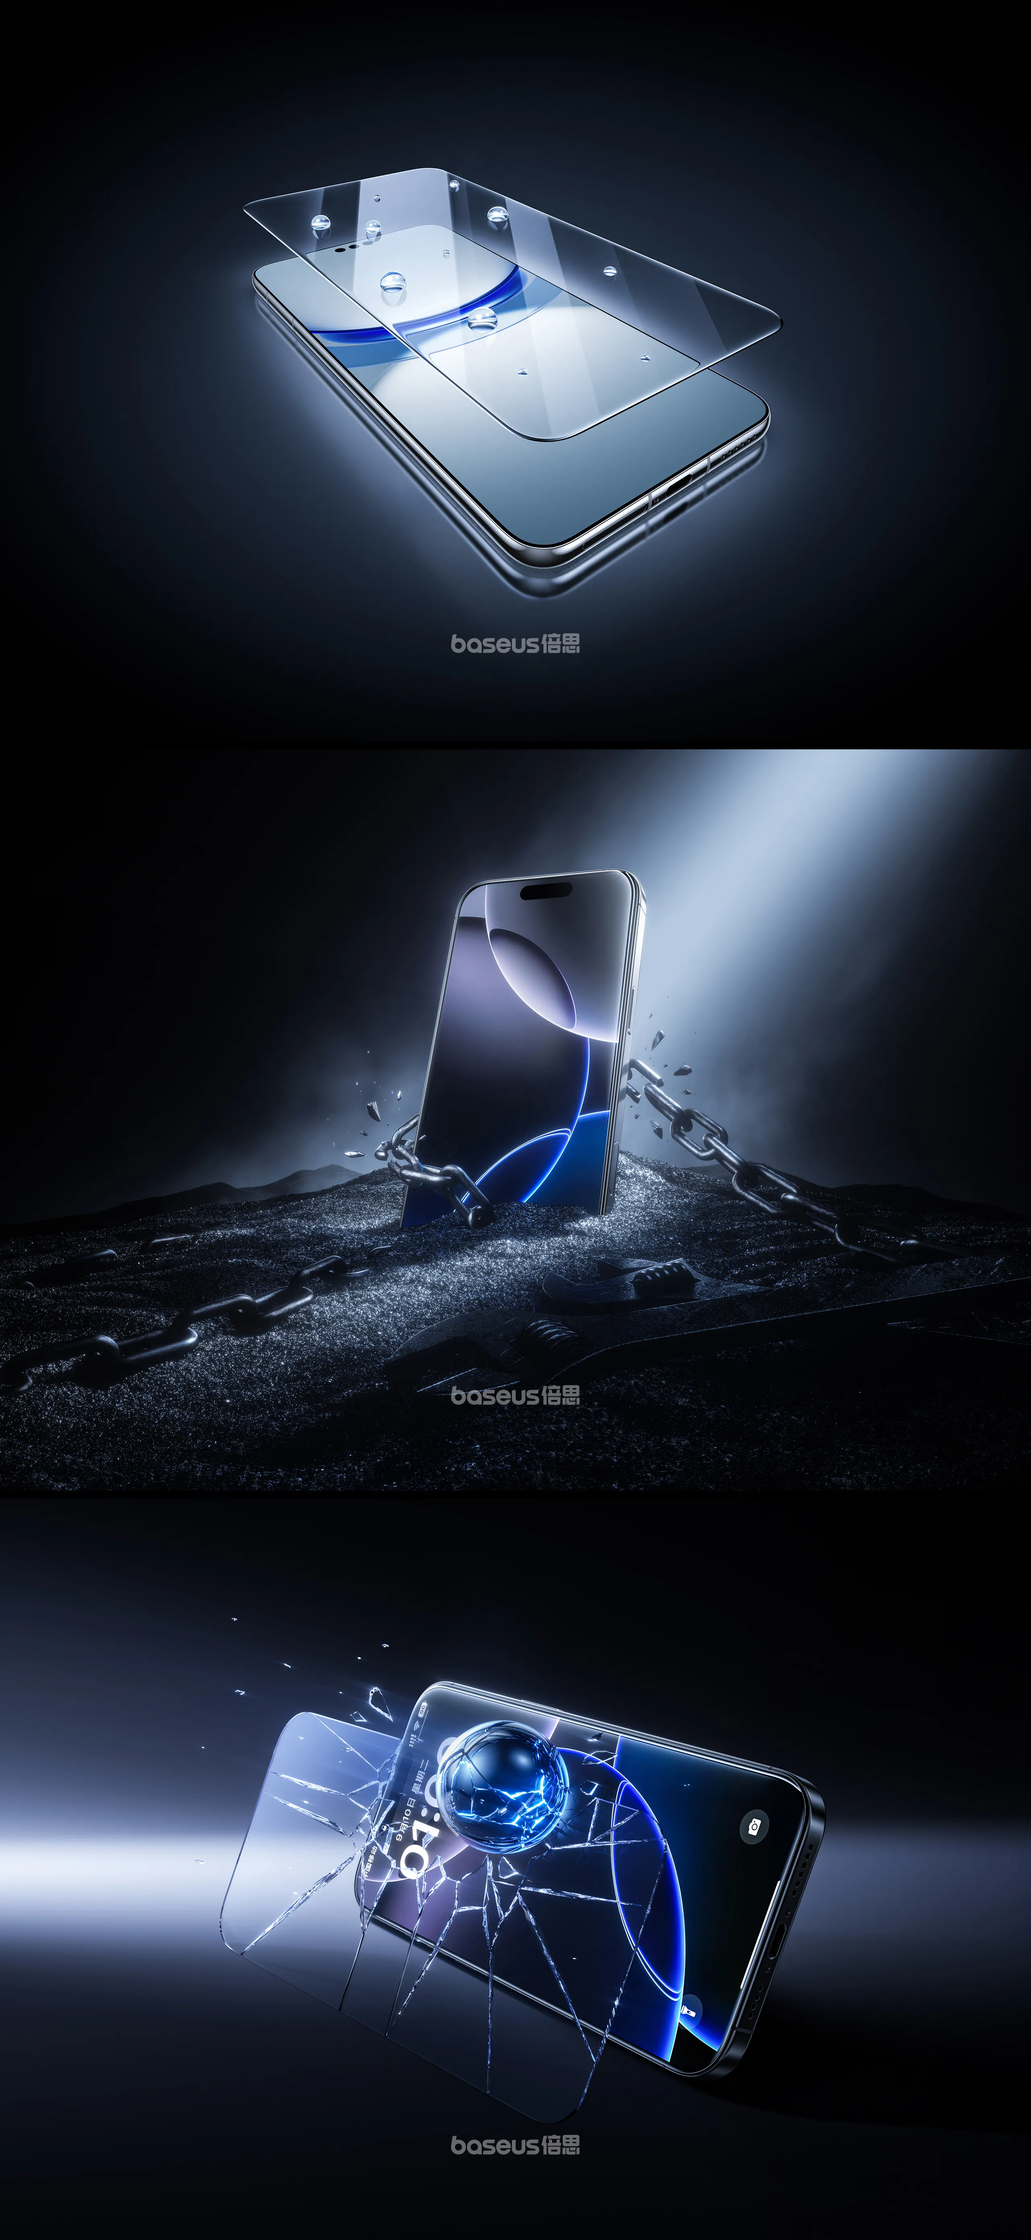


PART ONE
Company Introduction

Slide 4

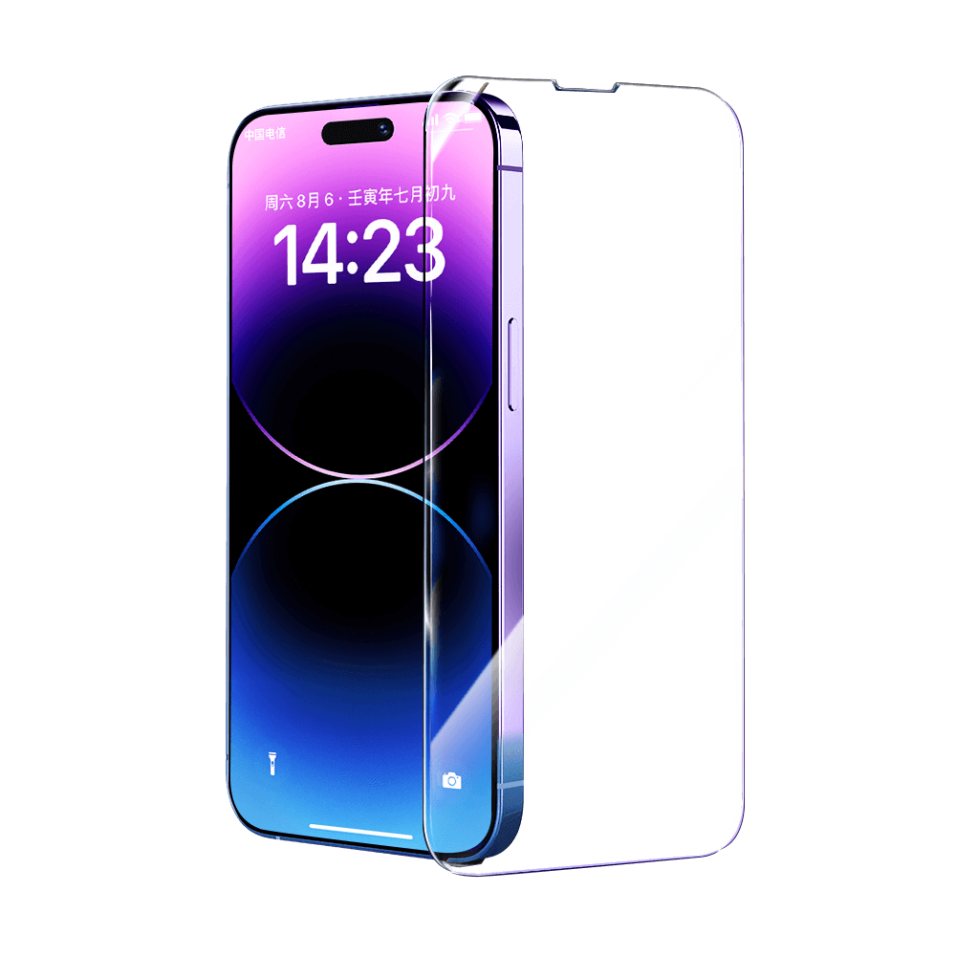

ABOUT
SHANMO
Professional Manufacturer & Exporter of Premium Mobile Screen Protectors
SCREEN PROTECTOR SPECIALIST SINCE 2015
Founded 2015 · Shenzhen, China · 50M+ Units Annual Capacity
WHO WE ARE
OUR PRODUCTS
OUR MISSION
Founded in Shenzhen, the world’s smartphone accessories capital.
Fully integrated supply chain:
raw material sourcing, precision cutting, coating & quality testing — all under one roof.
9H hardness aluminosilicate glass, engineered to meet international durability & clarity standards.
Every unit passes drop resistance, scratch resistance & light transmittance testing.
Serving Southeast Asia, Middle East & Europe — 50M+ units/year capacity.
Factory-direct pricing with uncompromising quality. Now proudly entering the Malaysian market.

Slide 5
PART TWO
Market Background

Slide 6

MALAYSIA: OUR IDEAL HIGH-GROWTH ENTRY MARKET
STRONG PURCHASING POWER
MASSIVE USER BASE
MATURE CHANNELS
Ranks top 3 in ASEAN for
purchasing power
A highly mature smartphone
market, 92% penetration rate
Most of consumers buy
3C accessories via e-commerce
$13K
31M+
76%
GDP per capita
smartphone users
purchase via e-commerce
RIGID DEMAND
FRIENDLY ENTRY
High annual screen protector demand
High repeat consumption
High acceptance of Chinese brands
RCEP tariff benefits
55M+
annual screen protector demand

Slide 7
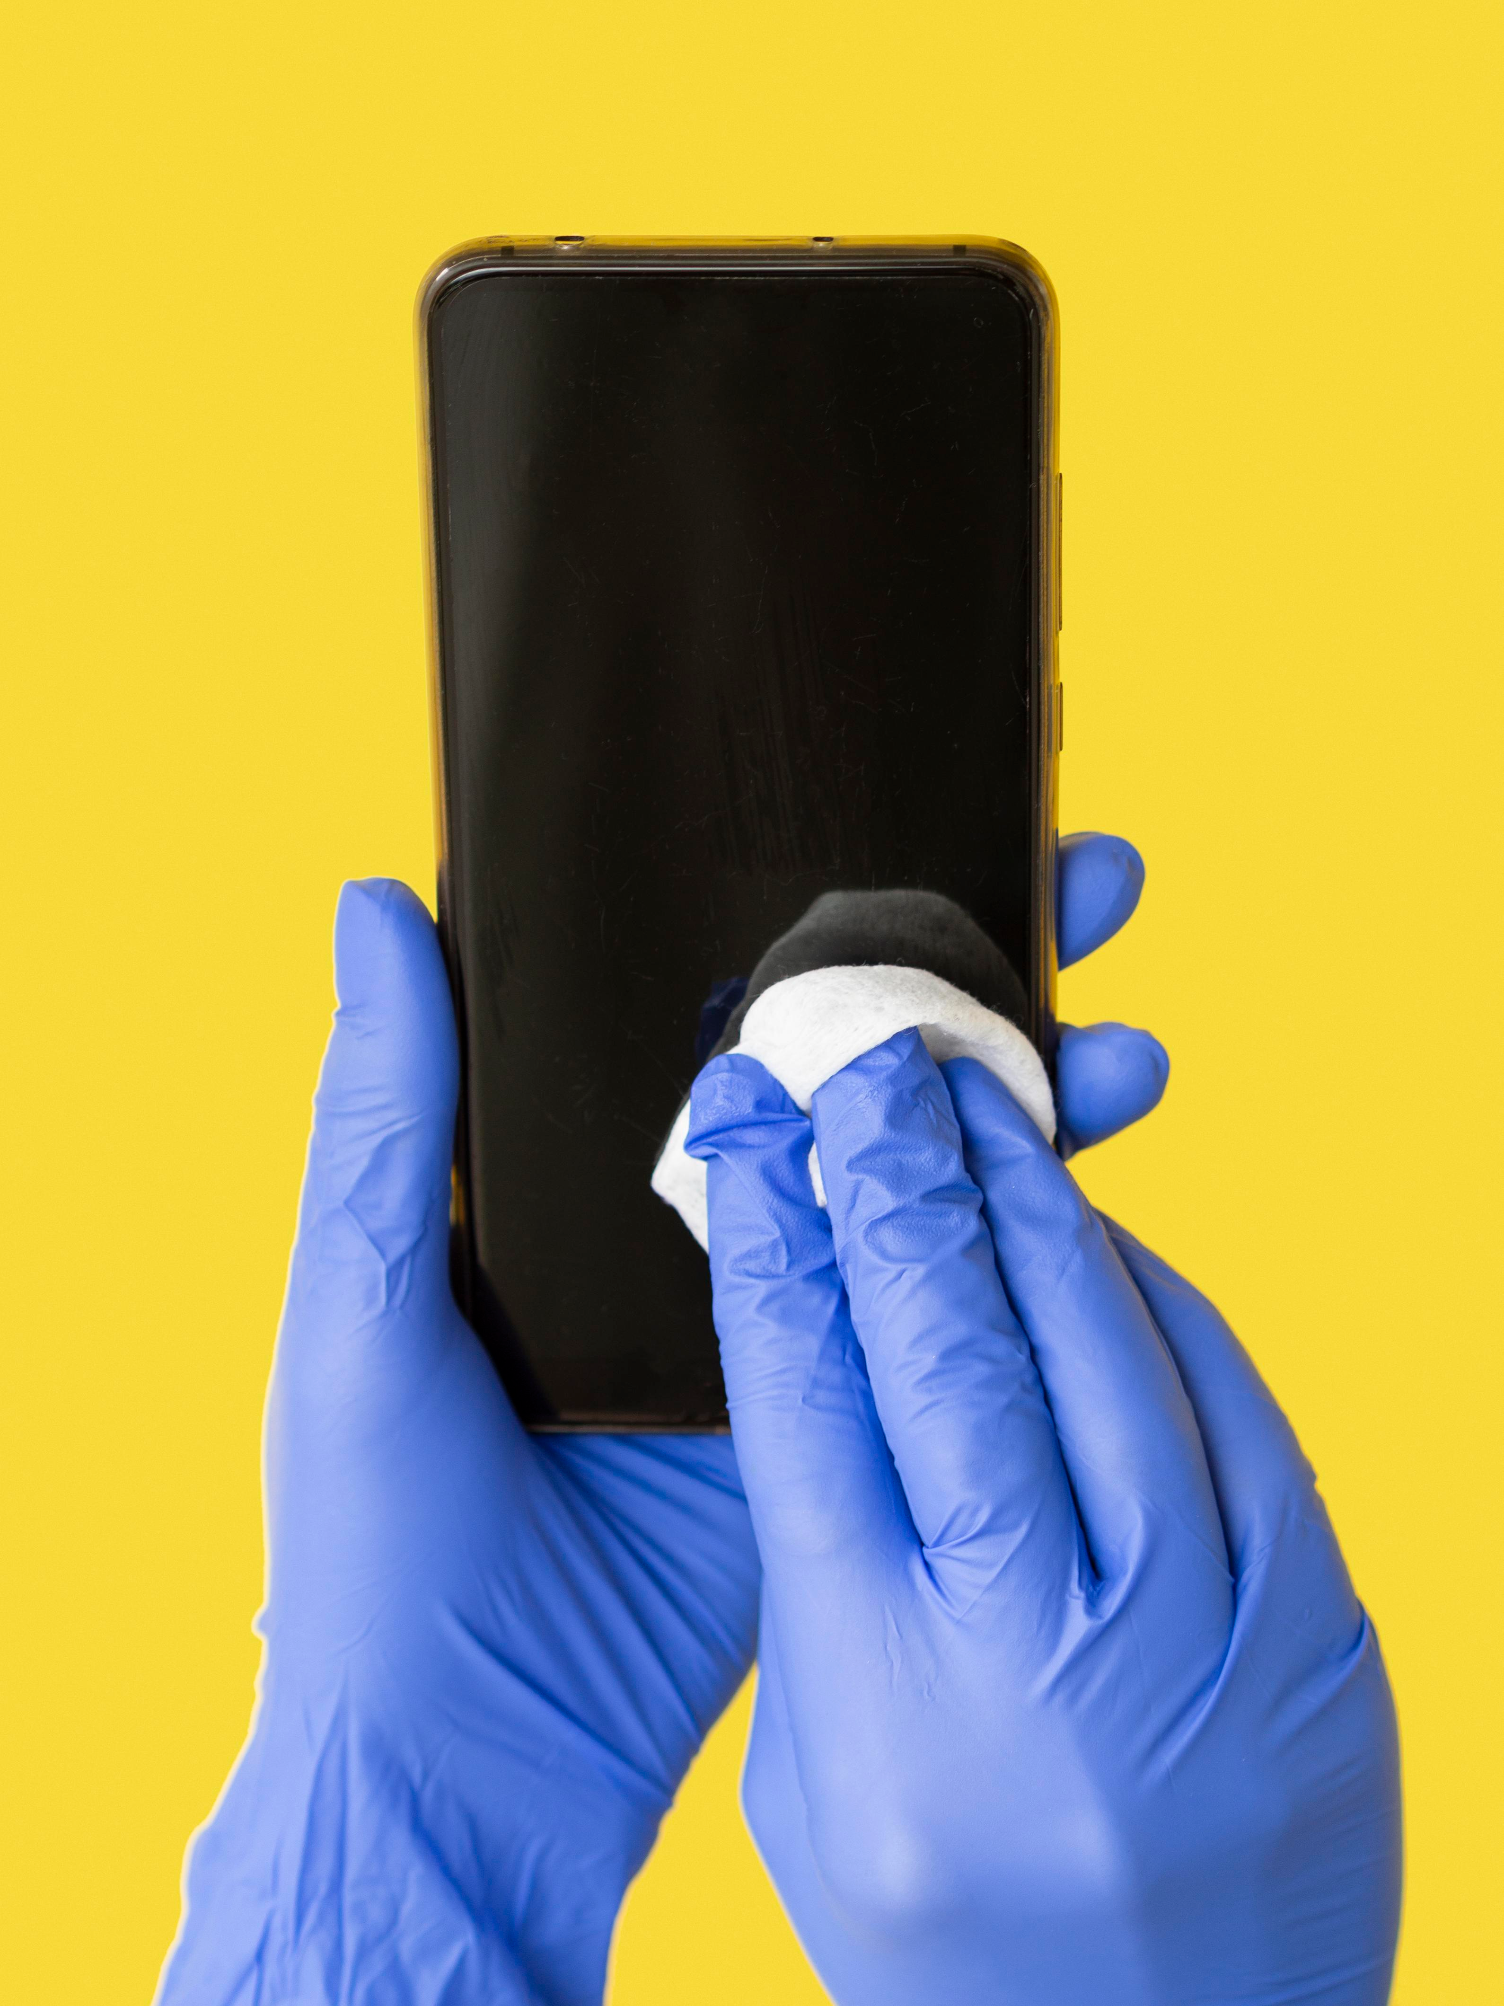
3 CRITICAL PAIN POINTS
LOCAL MARKET FAILS TO SOLVE
However, this booming market has three critical unmet pain points.
01.
POLARIZED SUPPLY
Premium brands overpriced (≥30 MYR)
Cheap white-label has poor quality & no warranty
02.
HIGH APPLICATION FRICTION
Manual application causes bubbles/misalignment
Offline service costs extra time & fees
03.
CLEAR CATEGORY GAP
No leading brand for foolproof one-step self-adhesive
screen protectors

Slide 8
PART THREE
Product Benefits

Slide 9





Core Advantage 1: Ease to Operate
Innovative Design: Built-in Dust Removal Chamber
The unique dust-free chamber design features a built-in dust removal strip, which automatically clears dust from the screen with a single pull, eliminating dust interference at the source.
Easy Operation: No Failure for New Users
With precise positioning assistance, it eliminates bubbles and white edges. Even first-time users who have never applied a screen protector before can easily align it and complete the process in one step.
Upgraded Experience: Efficient & Convenient
It significantly reduces the screen protector application failure rate, simplifying the tedious process into a simple and efficient one, allowing users to enjoy the convenience brought by technology.

Slide 10

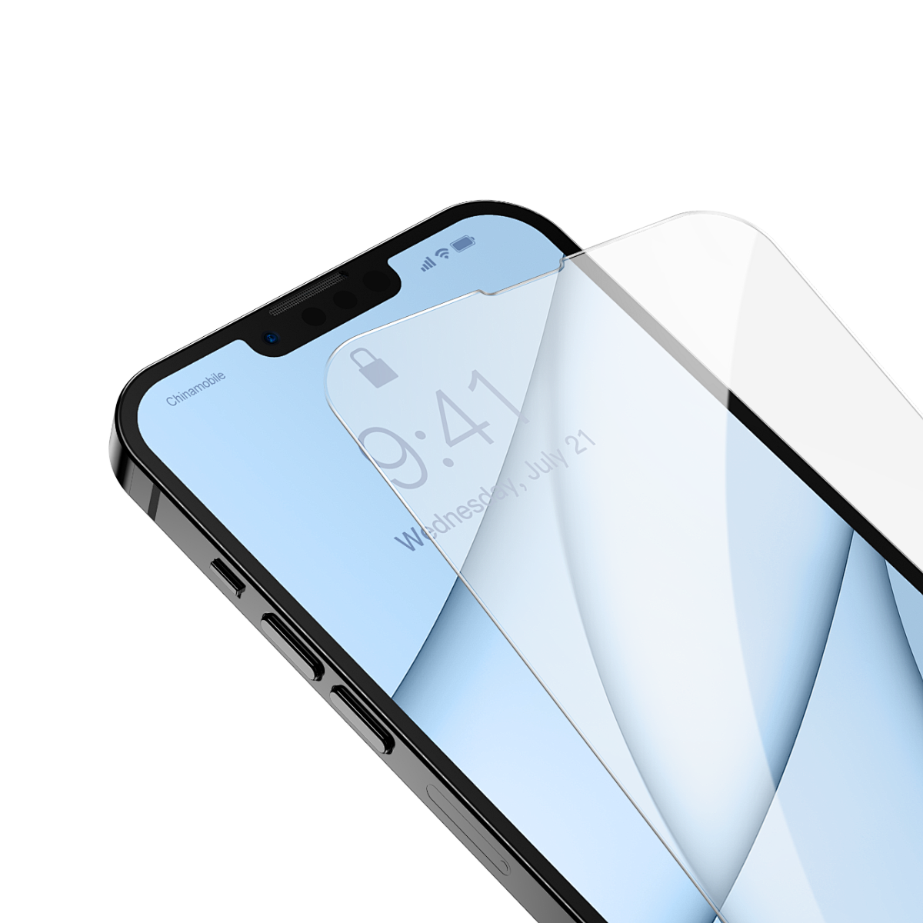

Core Advantage 2: Low Cost
Factory Direct Supply, No Middleman Markup
Direct supply from the source factory eliminates multiple distribution layers, cutting procurement costs and boosting profit margins.
Large-scale Production for Lower Unit Cost
Bulk standardized production amortizes R&D, mold and labor costs, making product prices highly competitive.
Offline-free Operation, Reduced Comprehensive Cost
Priced far lower than in-store film application and retail prices in Malaysia, helping distributors and consumers save significantly on expenses.

Slide 11





Core Advantage 3: Ease to Transport
Light and Thin in Volume, Lower Logistics Costs
Light, thin and compact products cut sea/air freight and last-mile delivery costs, boosting overall export profits.
Robust Moisture-proof Packaging, Safer Transportation
Hard inner lining with moisture-proof outer packaging resists pressure and falls, ideal for long-distance cross-border transport and greatly lowering transit damage risks.
Standardized Sizes, High Stacking and Loading Efficiency
Standardized, regular-shaped products stack easily, ensuring high storage and container loading rates for convenient stock preparation, sorting and bulk delivery.

Slide 12
PART FOUR
Export Solution

Slide 13
Export Plan for SHANMO
Core Export Positioning
Target Markets
Mid-to-low-end consumer electronics markets in Southeast Asia, the Middle East and Europe, where there is strong demand for cost-effective products with clear requirements for scratch resistance and shatterproof performance.
Target Markets
Product Selling
Points
Product Selling Points
9H hardness + 0.33mm ultra-thin design, combining high-definition transparency and sensitive touch control, focusing on cost-effective protection.
Trade Terms
FOB Shenzhen Port, small-batch trial orders (1,000–5,000 pieces) + bulk customization (supporting OEM/ODM branding).
Trade Terms

Slide 14
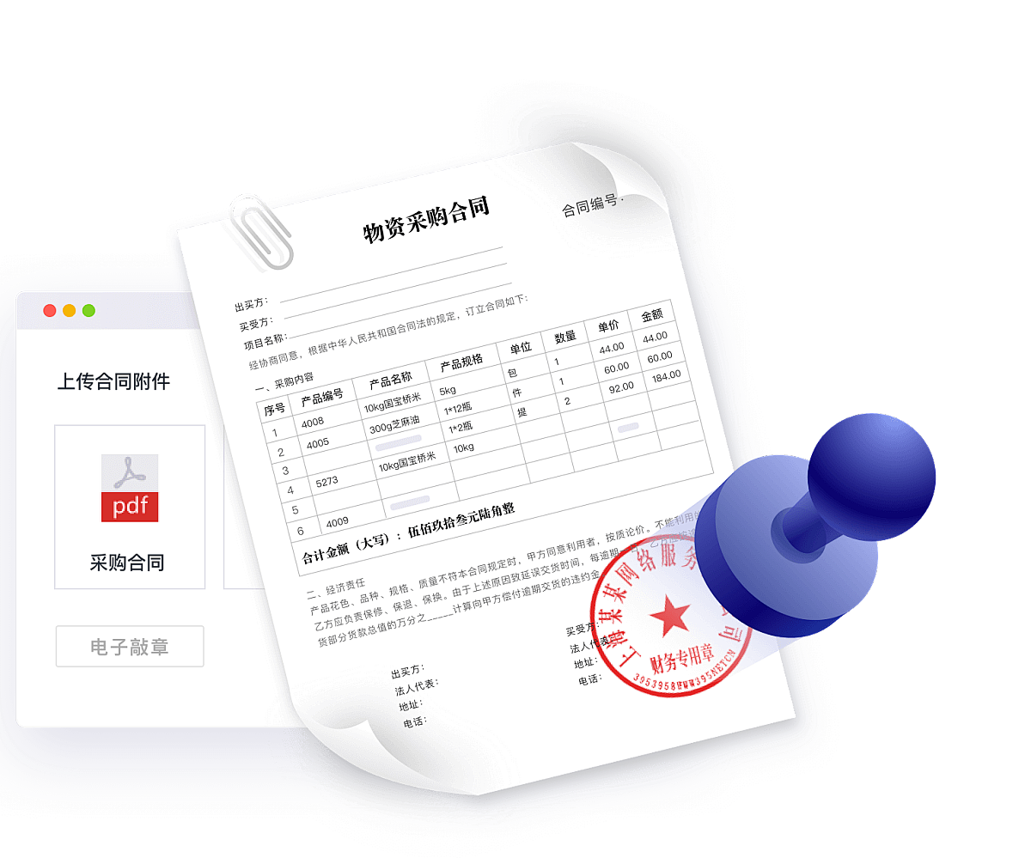



Export Plan for SHANMO
Export Process Planning
Qualification Preparation
Supply Chain Optimization
Logistics and Payment
After-Sales Guarantee
Completed CE and RoHS certifications (as marked), prepare customs declaration and inspection documents, and provide English product instructions and safety warnings.
Negotiate lightweight packaging with factories to reduce logistics costs, and maintain sufficient inventory of universal models compatible with mainstream devices.
Adopt a combination of sea and air transportation; support T/T (Telegraphic Transfer) and L/C (Letter of Credit) to ensure financial security.
Provide 1% spare parts for loss compensation, and establish overseas warehouses (cooperate with third parties in the initial stage) to shorten delivery cycles.

Slide 15








Team Members
Diverse Expertise, United Vision
Leader｜ JIA FUNING
Major：Computer Science
Member｜ WANG JIAXIN
Major：English
Member｜ SHA SHUAIQI
Major：Finance
Member｜ LIU YUHAN
Major：Marketing
Member｜ LI YUTONG
Major：Marketing
Member｜ WANG LUYING
Major：Business Administration

Slide 16

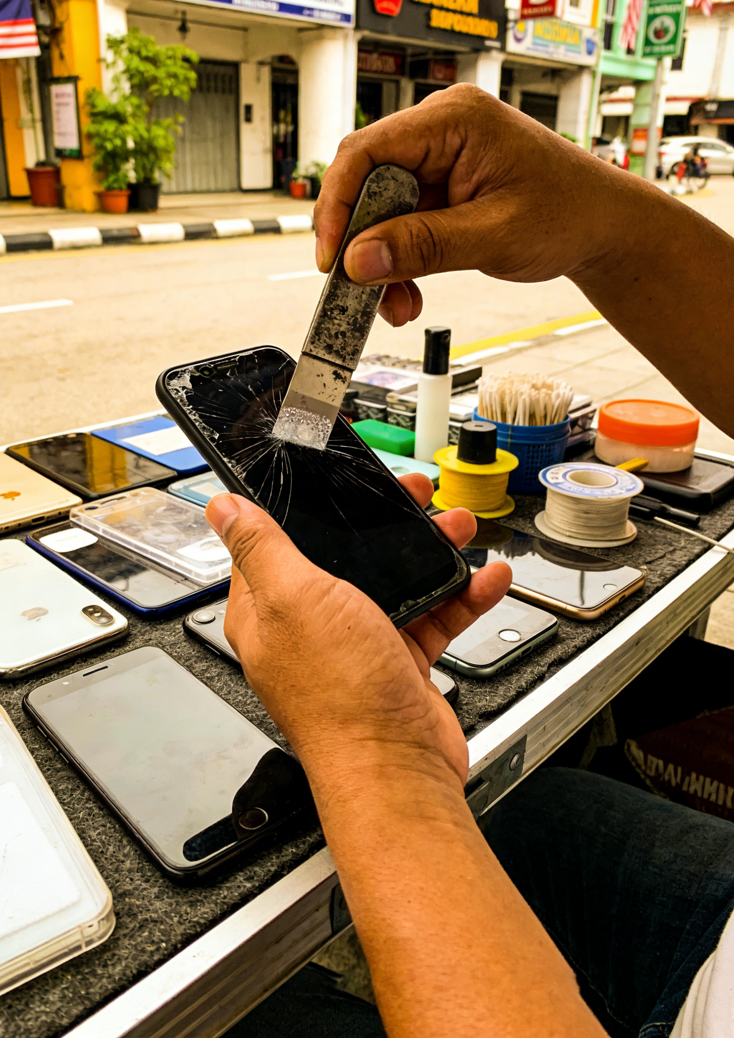
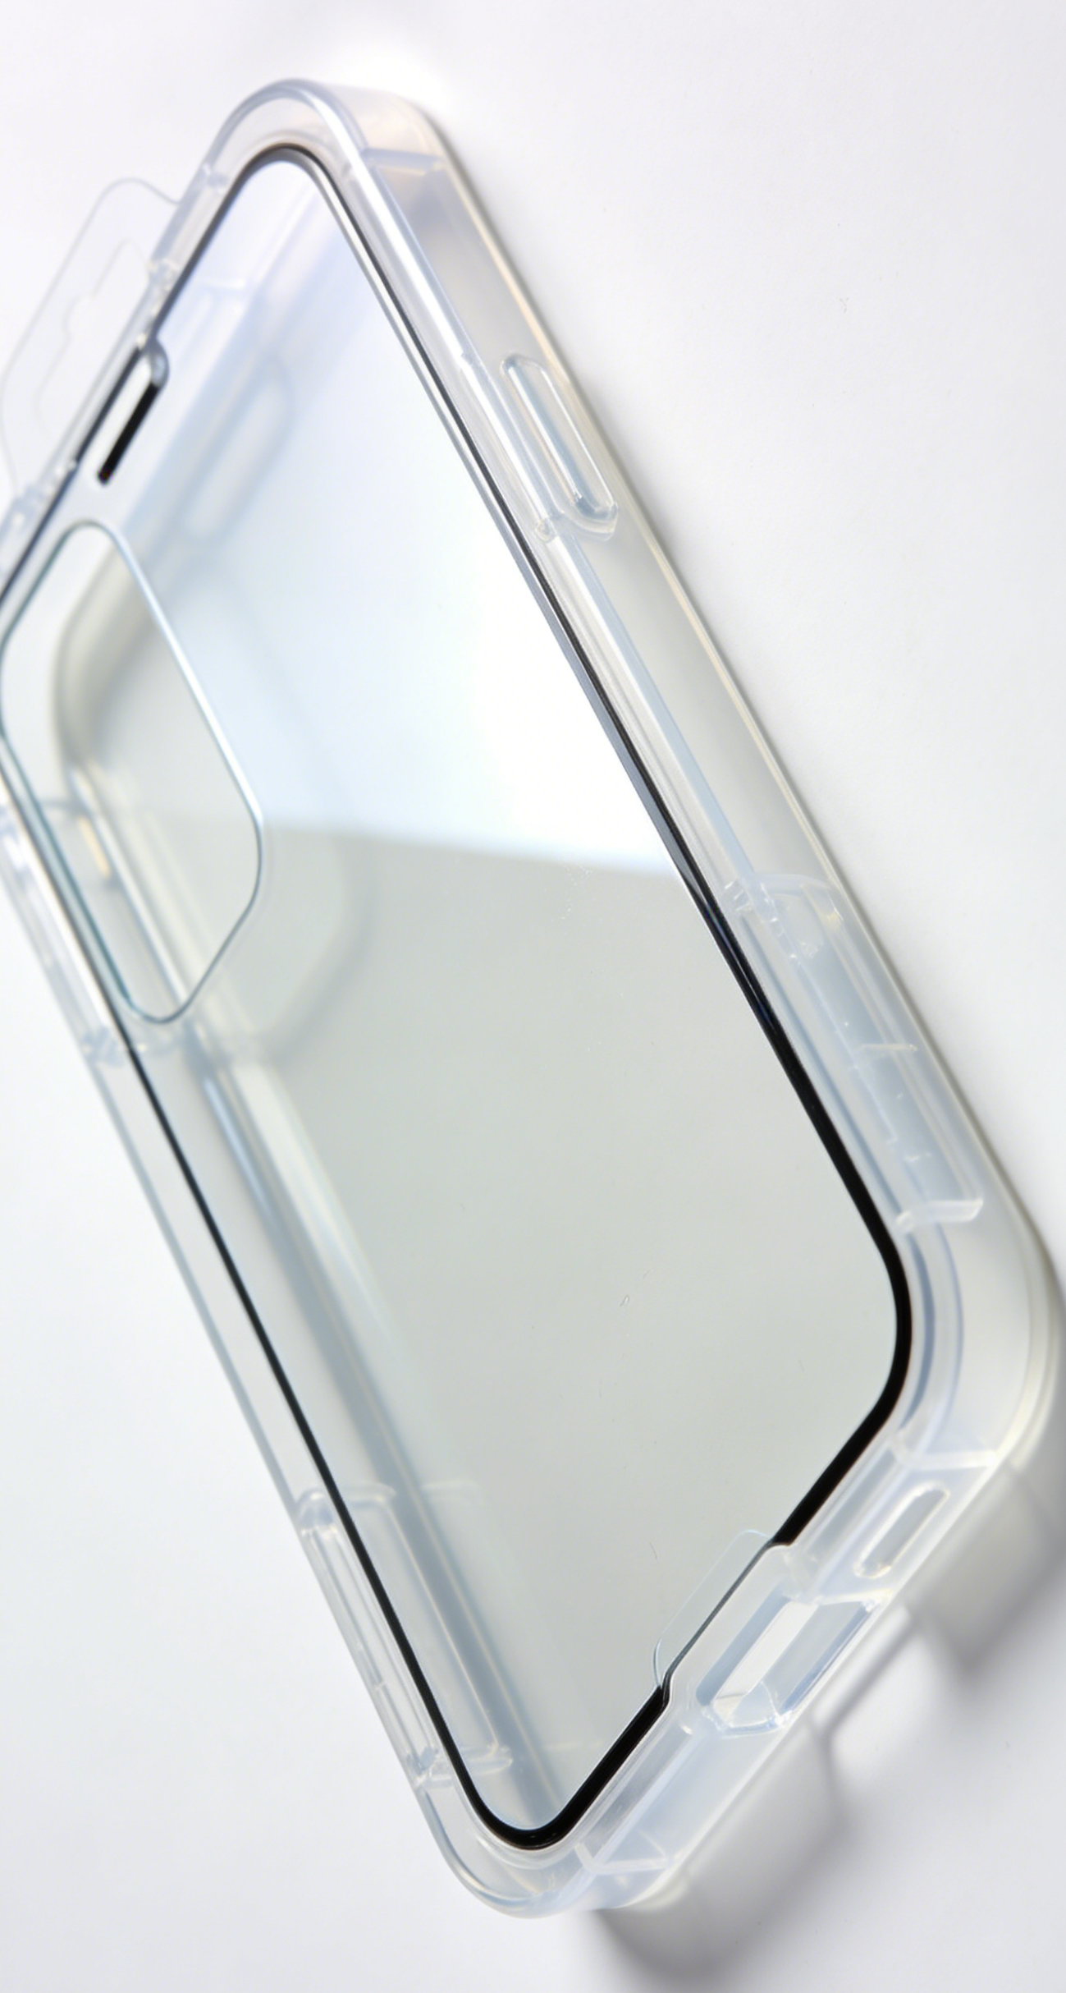
Beyond Business: A Bond of Friendship
Connecting Shenzhen & Malaysia, Technology & Trust
“A Small Film, A Big Connection”

Slide 17


Thank You for Watching
SHANMO
Malaysia Market Product Launch Event

